Slide 1
Further Resources

Slide 2
Objectives
After completing this module, you should be able to
tbd

Slide 3
What do I do now?
To learn more you are going to need more practice and more resources. It takes a village and a couple of web servers.
Provide you with resources that you can read
Provide you with resources that you can watch
Provide you with resources that you can listen
Provide you with resources that you can attend

Slide 4
https://goo.gl/cExAi1
The slides from this workshop.

Slide 5
docs.chef.io

Slide 6
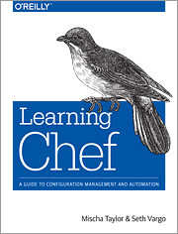
Learning Chef
A Guide to Configuration Management and Automation

Slide 7
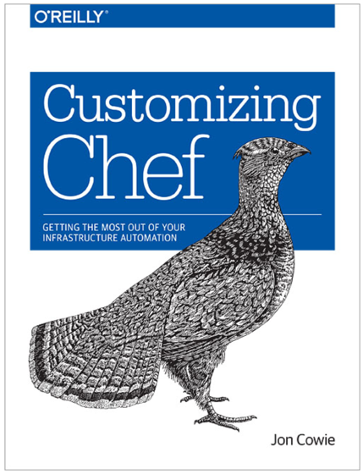
Customizing Chef
Getting the Most Out of Your Infrastructure Automation

Slide 8
learnchef.com
Activity focused learning for those new to Chef.

Slide 9
What do I do now?
To learn more you are going to need more practice and more resources. It takes a village and a couple of web servers.
Provide you with resources that you can read
Provide you with resources that you can watch
Provide you with resources that you can listen
Provide you with resources that you can attend

Slide 10
Youtube Channel
ChefConf Talks
Training Videos
https://www.youtube.com/user/getchef/playlists

Slide 11

foodfightshow.org
Food Fight is a bi-weekly podcast for the Chef community. We bring together the smartest people in the Chef community and the broader DevOps world to discuss the thorniest issues in system administration.

Slide 12
What do I do now?
To learn more you are going to need more practice and more resources. It takes a village and a couple of web servers.
Provide you with resources that you can read
Provide you with resources that you can watch
Provide you with resources that you can listen
Provide you with resources that you can attend

Slide 13

theshipshow.com
The Ship Show is a twice-monthly podcast, featuring discussion on everything from build engineering to devops to release management, plus interviews, new tools and techniques, and reviews.

Slide 14
foodfightshow.org
Food Fight is a bi-weekly podcast for the Chef community. We bring together the smartest people in the Chef community and the broader DevOps world to discuss the thorniest issues in system administration.

Slide 15
What do I do now?
To learn more you are going to need more practice and more resources. It takes a village and a couple of web servers.
Provide you with resources that you can read
Provide you with resources that you can watch
Provide you with resources that you can listen
Provide you with resources that you can attend

Slide 16
Chef Developers' IRC Meeting
Join members of the Chef Community in a meeting for Chef Developers where we’ll discuss the future of the Chef project and other things pertinent to the community.
irc.freenode.net#chef-hacking
https://github.com/chef/chef-community-irc-meetings

Slide 17
Chef Community Summit
The Chef Community will gather for two days of open space sessions and brainstorm on Chef best practices.
The Chef Community Summit is a facilitated Open Space event. The participants of the summit propose topics, organize an agenda, and discuss and work on the ideas that are most important to the community.
https://www.chef.io/summit/

Slide 18
ChefConf
It’s the gathering of hundreds of Chef community members. We get together to learn about the latest and greatest in the industry (both the hows and the whys), as well as exchange ideas, brainstorm solutions, and give hugs, which has become the calling card of the DevOps community, and the Chef community in particular.
https://www.chef.io/chefconf/

Slide 19
Discussion
What questions can we answer for you?

Slide 20
Thank You!

